Slide 1


Judges Leave Information System
Concept:
Sh. Talwant Singh, Chairman Website Committee
Sh. Manoj Jain, Chairman Central Computer Committee

Slide 2
E-AVKASH – The Benefits
In hand Information updation Technology
Instant Information updated on the internet
Big help for all the stakeholder of the Courts i.e the Judges, Lawyers, Litigants and public at large
Information can be updated any time from any place
Keep track of all Leaves availed by Judicial Officer
Notes:
This brings us to the main subject of this presentation, namely trademarks.
We will be looking at what trademarks are, their function and value from a business perspective, why it is important to protect your trademark and various other practical aspects related to the registration and enforcement of trademarks.

Slide 3
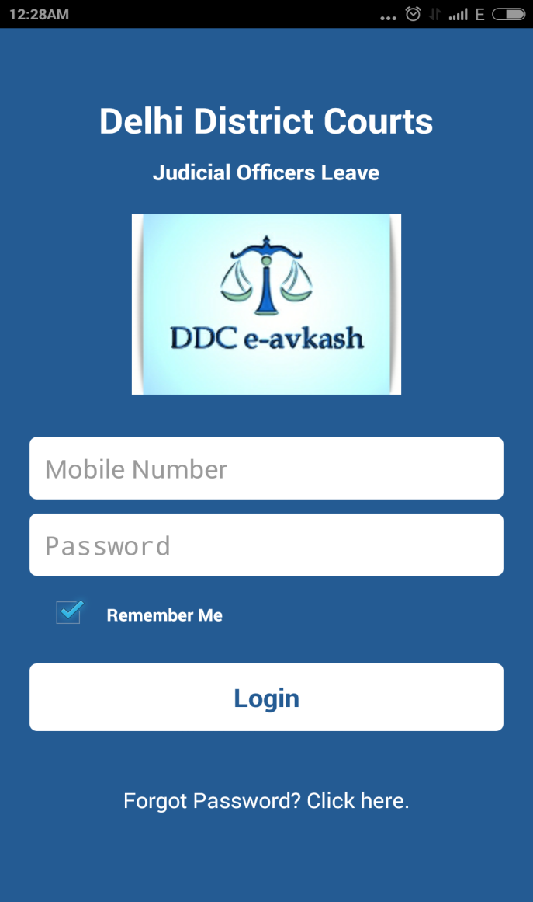
E-AVKASH – Login
Default username set as registered mobile number of the Judicial Officer
Password to be set and communicated by the Administrator
Compulsory to change the password at first time use

Slide 4
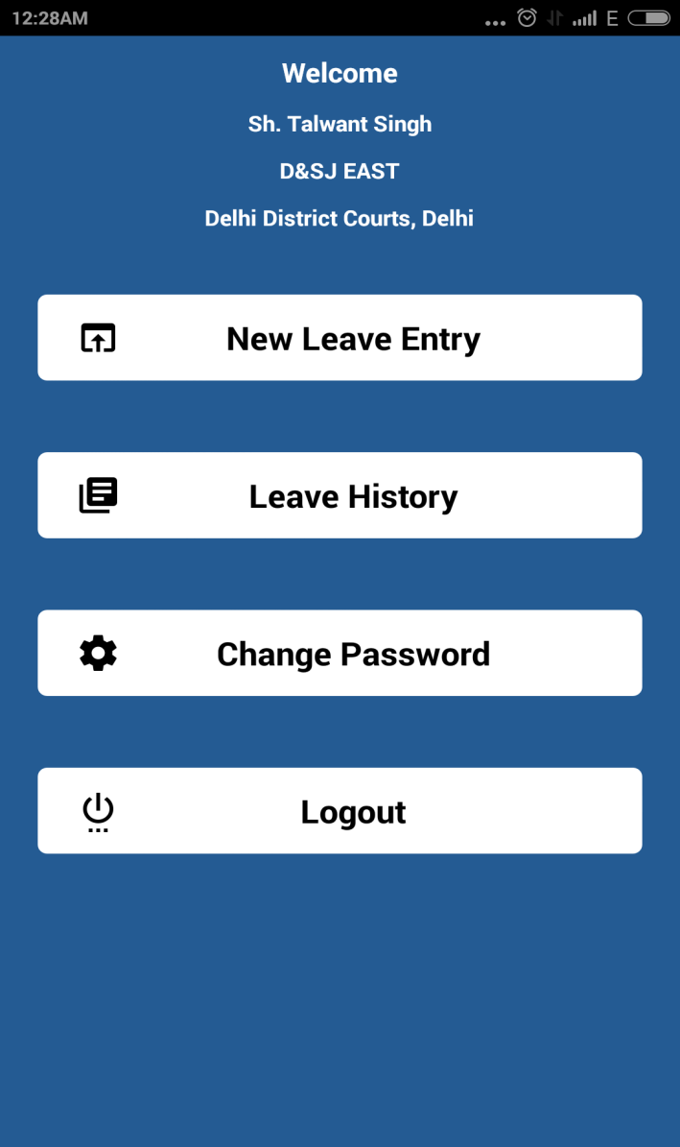
E-AVKASH – Dash Board
New Leave Entry
Leave History
Change Password
Logout..

Slide 5
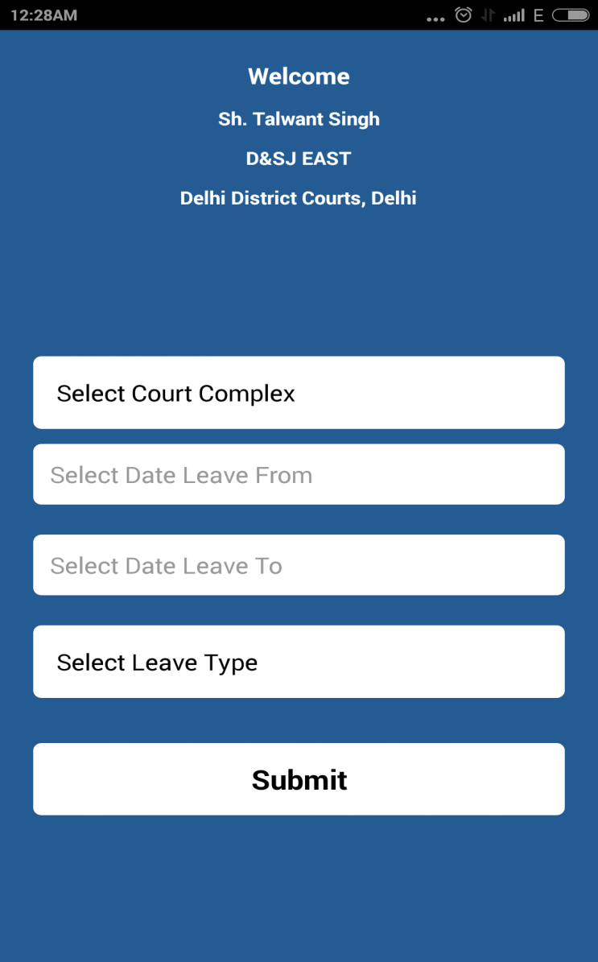
E-AVKASH – New Leave Entry
Select Court Complex
Choose Start Leave date
Choose End Leave date

Slide 6
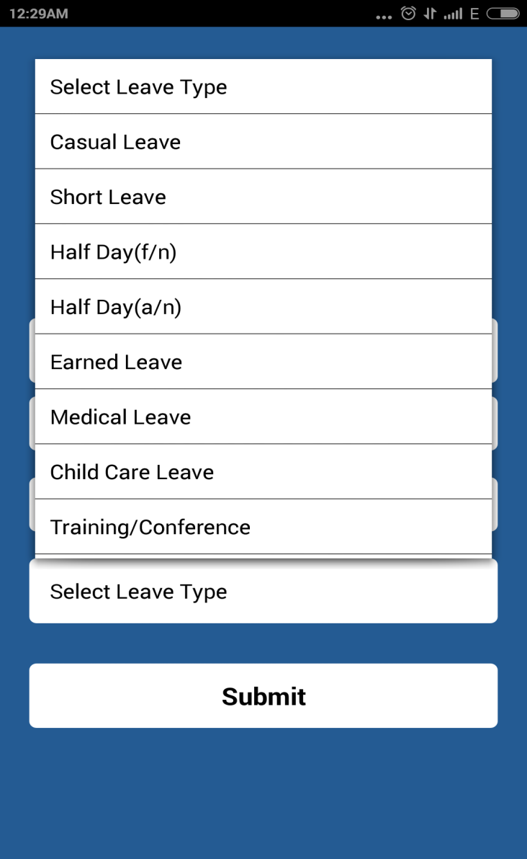
E-AVKASH – New Leave Entry
Select Leave Type or say the Nature of Leave
Submit and its done
Information successfully updated

Slide 7
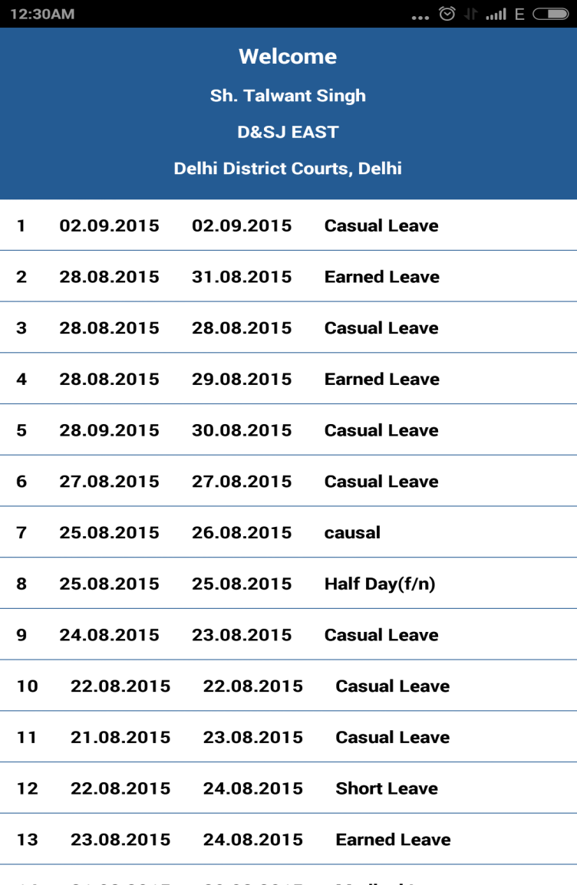
E-AVKASH – Leave History
Keeps a track of all the leaves taken by the Judicial Officer
Helps in managing leaves more conveniently

Slide 8
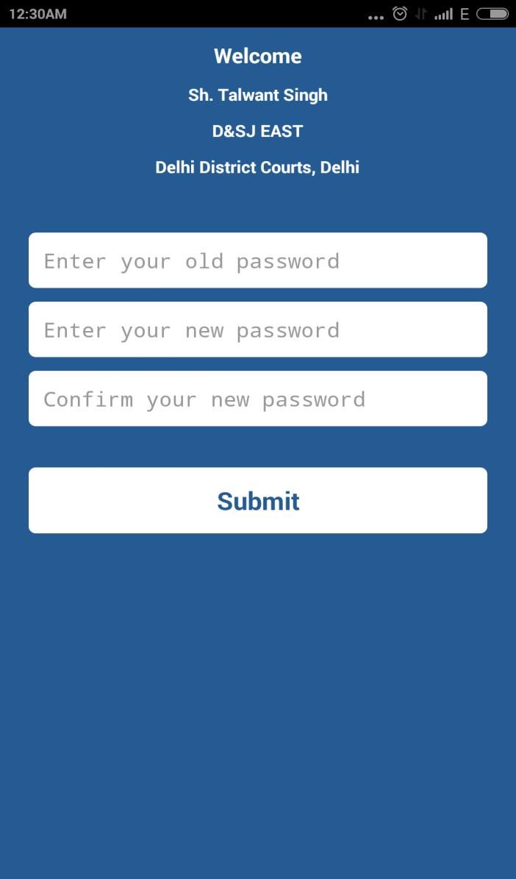
E-AVKASH – Change Password
User can change password as and when required for security purposes
Completely secured..

Slide 9
THANK YOU
FOR YOUR ATTENTION
Developed & Designed by:
Vinay, Lalit, Harish
Delhi District Courts
Notes:
This brings us to the main subject of this presentation, namely trademarks.
We will be looking at what trademarks are, their function and value from a business perspective, why it is important to protect your trademark and various other practical aspects related to the registration and enforcement of trademarks.

